Slide 1
BUSINESS DATA MANAGEMENT
CAPSTONE PROJECT
Case Study of Gupta Kirana Store
Name : Siddhant Saini
Roll No : 21f3002317
Email: 21f3002317@ds.study.iitm.ac.in

Slide 2

Contents
1) Executive Summary | Introduction to business
2) Data Collection & Cleaning | Data collection and Cleaning Steps
3) Data Analysis | Analysis done in respect to the challenges
4) Findings | Important Insights about business
5) Recommendation | Solutions / Recommendations for business

Slide 3
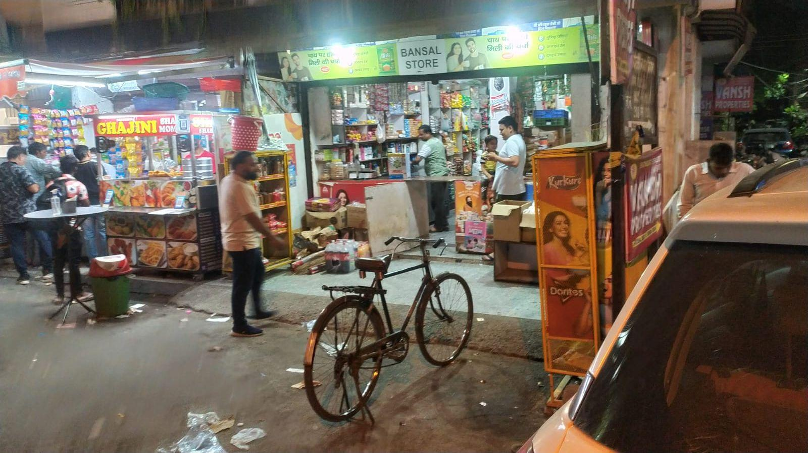

Executive summary
The business from where i collected data is a medium sized general purpose departmental store, started by Mr. Raj Gupta in early 2023.
The range of product sold by the store is generally cereals, grains, pulses, oils, milk and dairy products
Unfortunately the store has been encountering challenges in terms of
Profit , Sales
&
Inventory Management

Slide 4
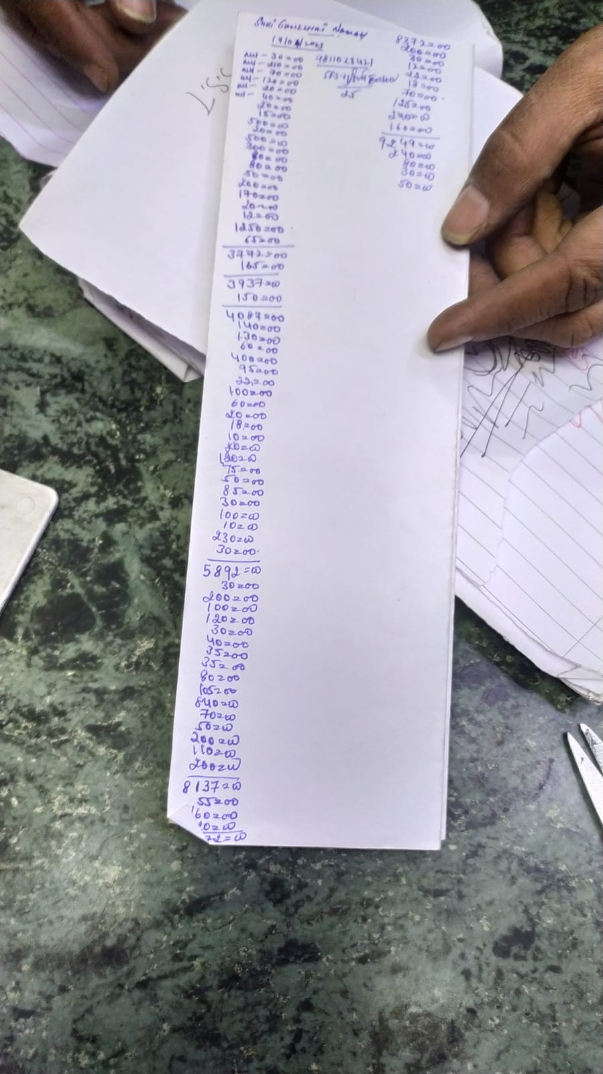

01
Data Collection & Cleaning
To collect data I went to store daily for 31 days and noted down the sales, purchase quantities, prices and inventory of 10 items
Data collected for analysis was primary data and was very raw
Hence to Consolidated and clean the data Google Sheets/Excel was used for data cleaning and future analysis.

Slide 5
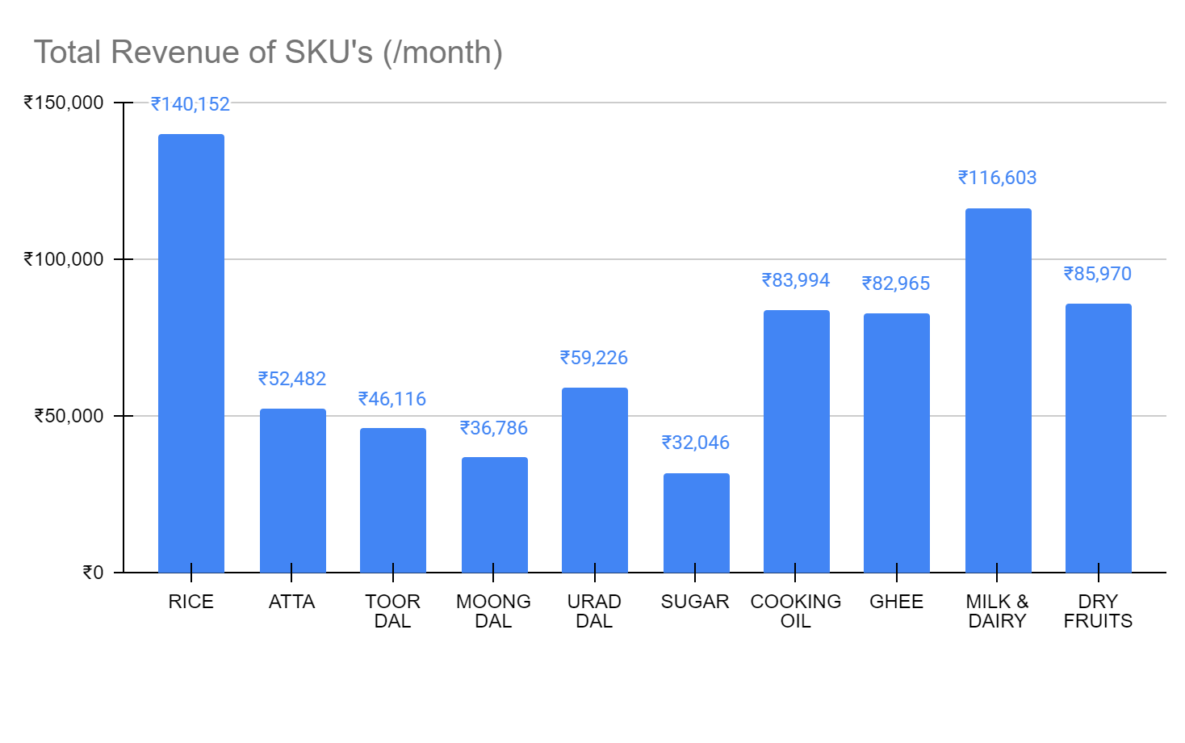
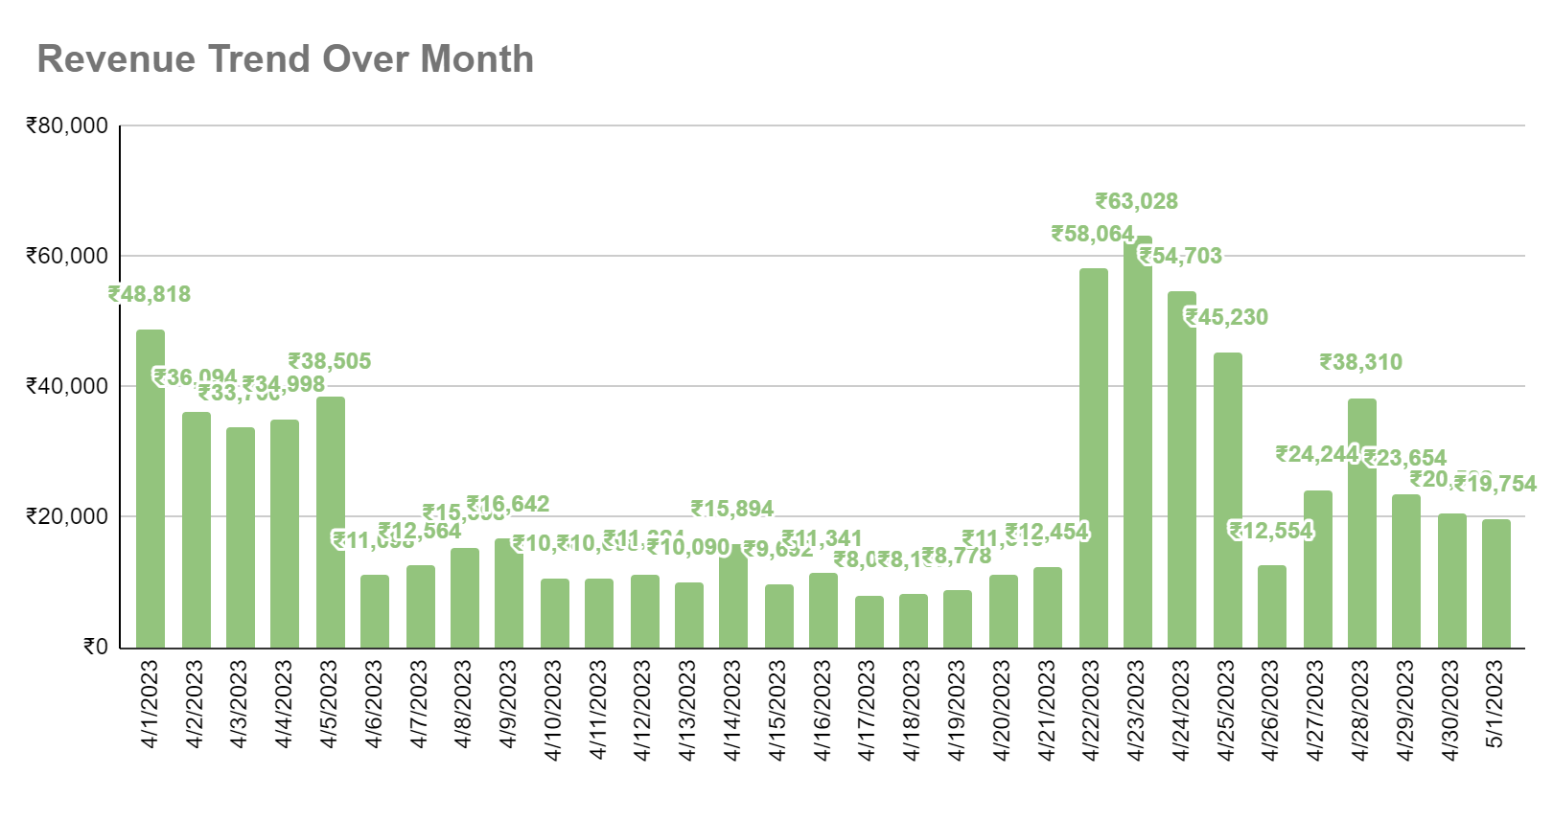
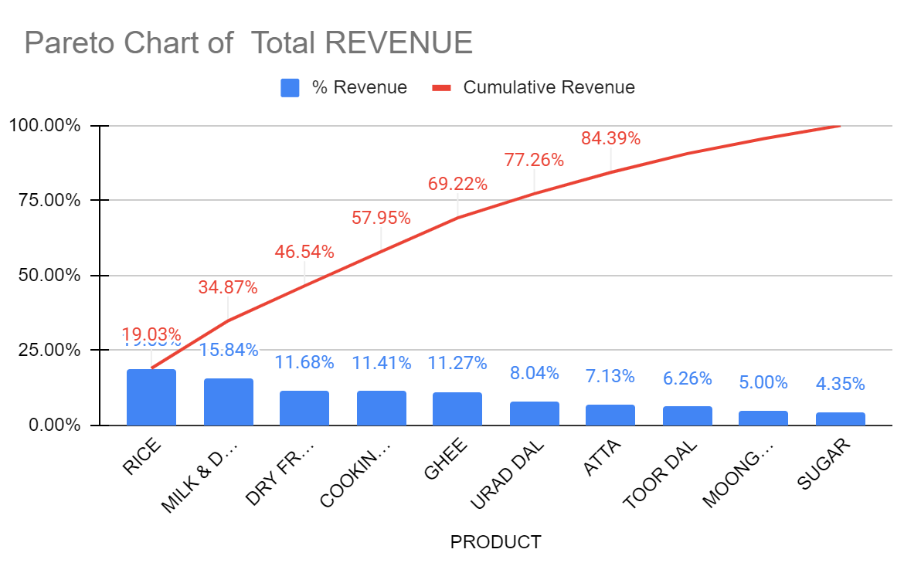

02
Data Analysis
Objective : 1 Sales
Rice , Milk & Dairy , Dry Fruits , Cooking Oil , Ghee and Urad Dal are the main revenue generating SKU
Highest revenue generating days : 22th - 28th
Average daily revenue : ₹23,753
deviation : ₹16557.77
Minimum revenue : ₹8,093
Maximum revenue : ₹63,028
Range : ₹54,935

Slide 6
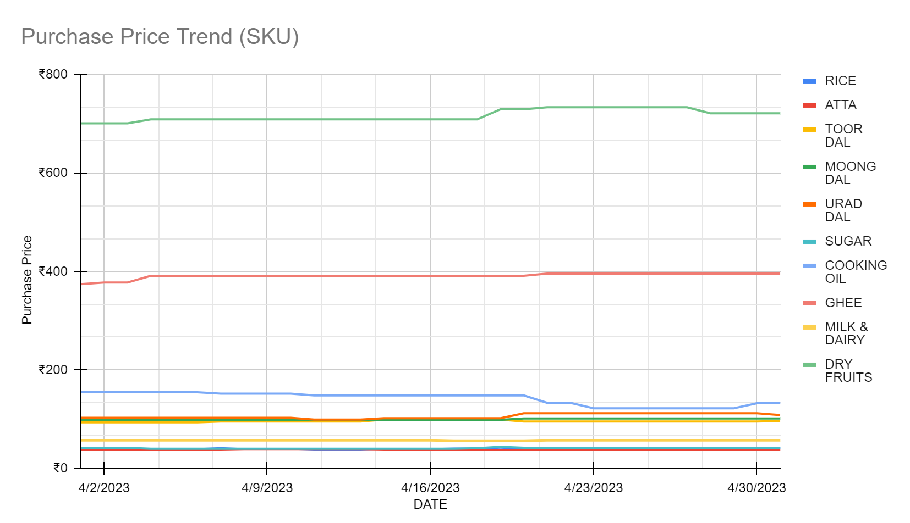
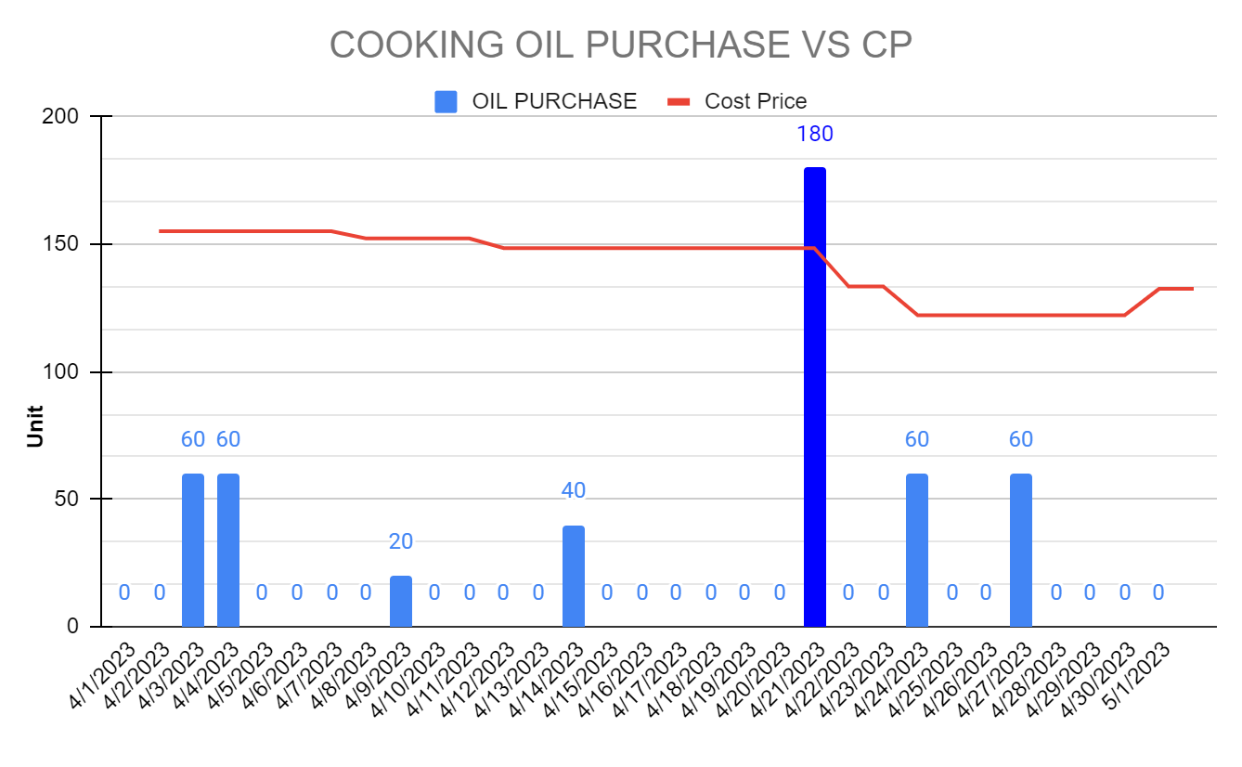
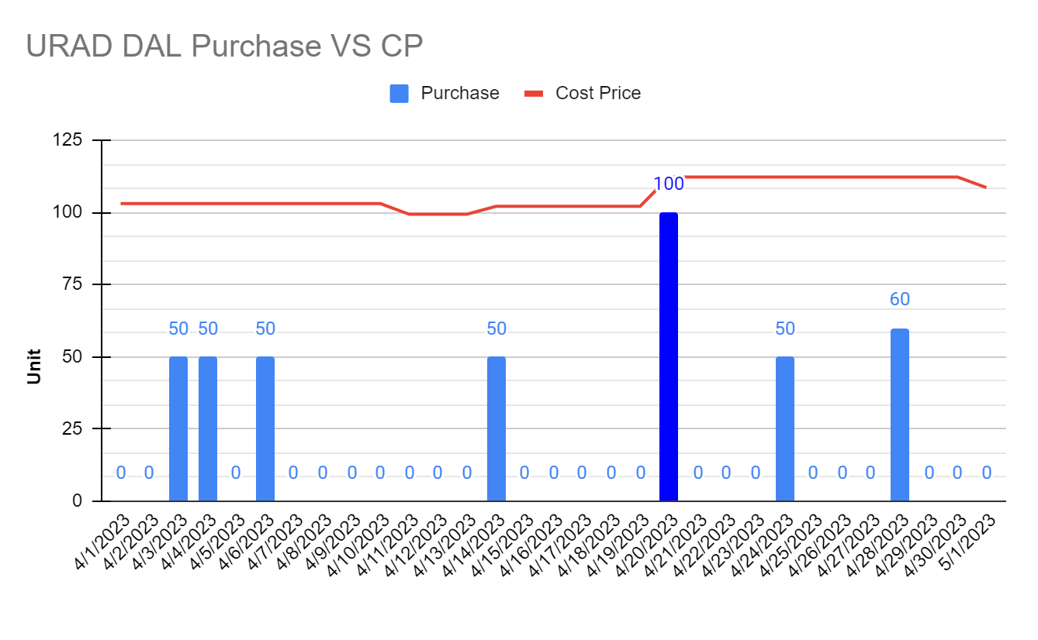
02
Data Analysis
Objective : 2 Purchase
Tends to be a slight increase in purchase price for most of the SKU’s at middle of month except :
Cooking oil purchase price tends to show a dip
Urad Dal purchase price tends to show a significant increase
Shop owner made two wrong purchases , which were when prices were high , and the seller have earned at least extra 10-15 Rs/Kg, if it would have been brought 2-3 days later or earlier in respective case

Slide 7
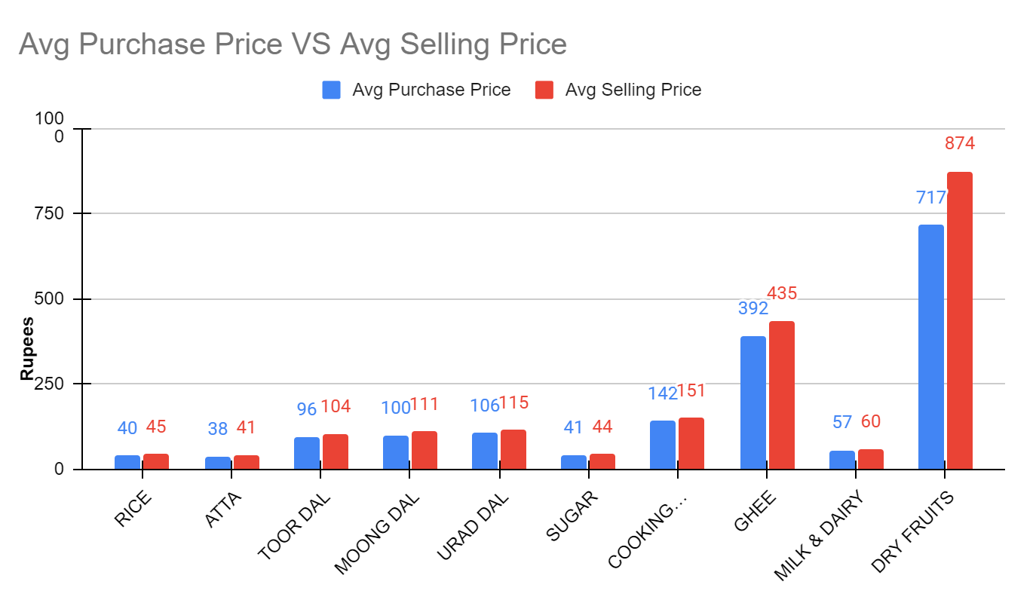
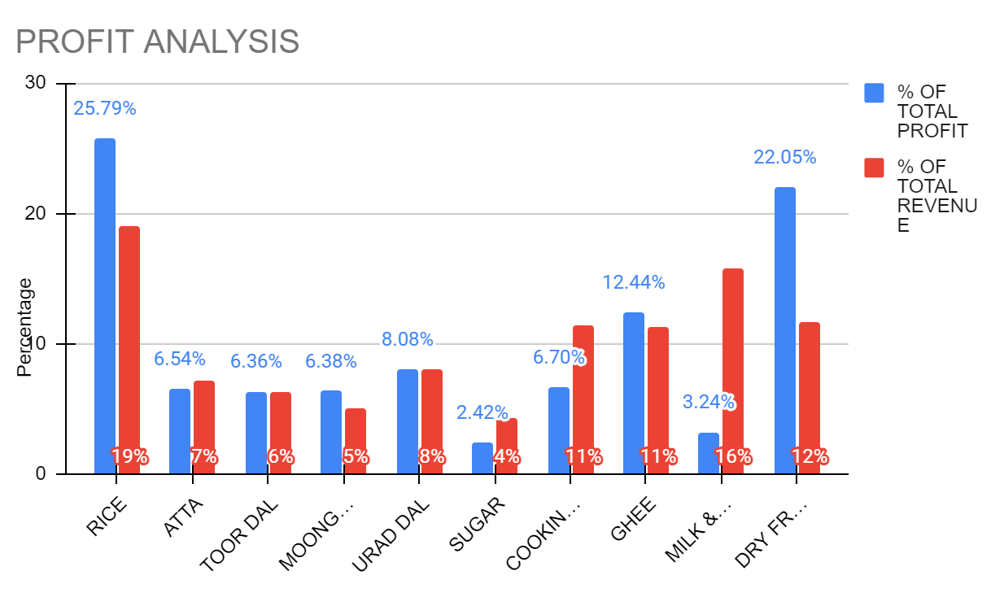
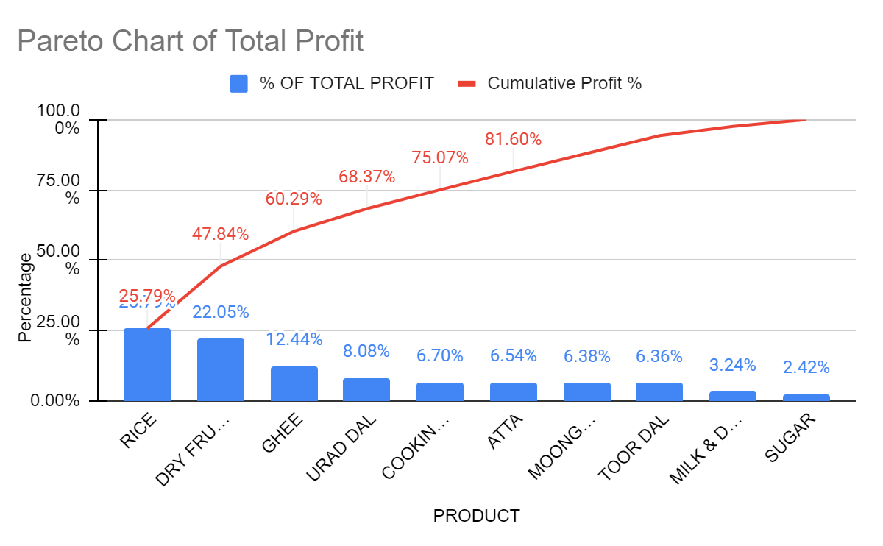
02
Data Analysis
Objective : 3 Profit / Loss
Rice , Dry Fruits , Ghee , Urad Dal , Cooking OIl and Atta are the 6 SKU contributing to the 80% of shop total profit
Dry Fruits and Ghee sales volume (1.1% and 2.1%) need to be improved for the shop to increase its net profit
Dry fruits and Ghee are the items that holds maximum profit generating capacity
Notes:
2-graph) shop is prosperous in Milk & Dairy , Cooking oil sales but their contribution to the overall profit remains significantly lower to that
of others hence lower net profit

Slide 8
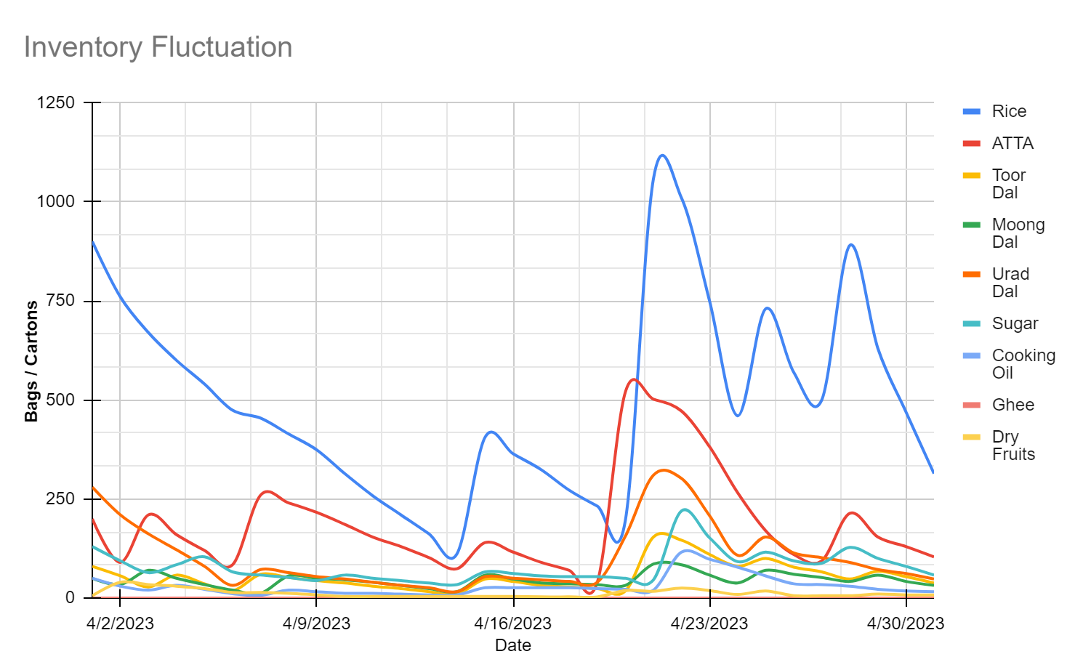
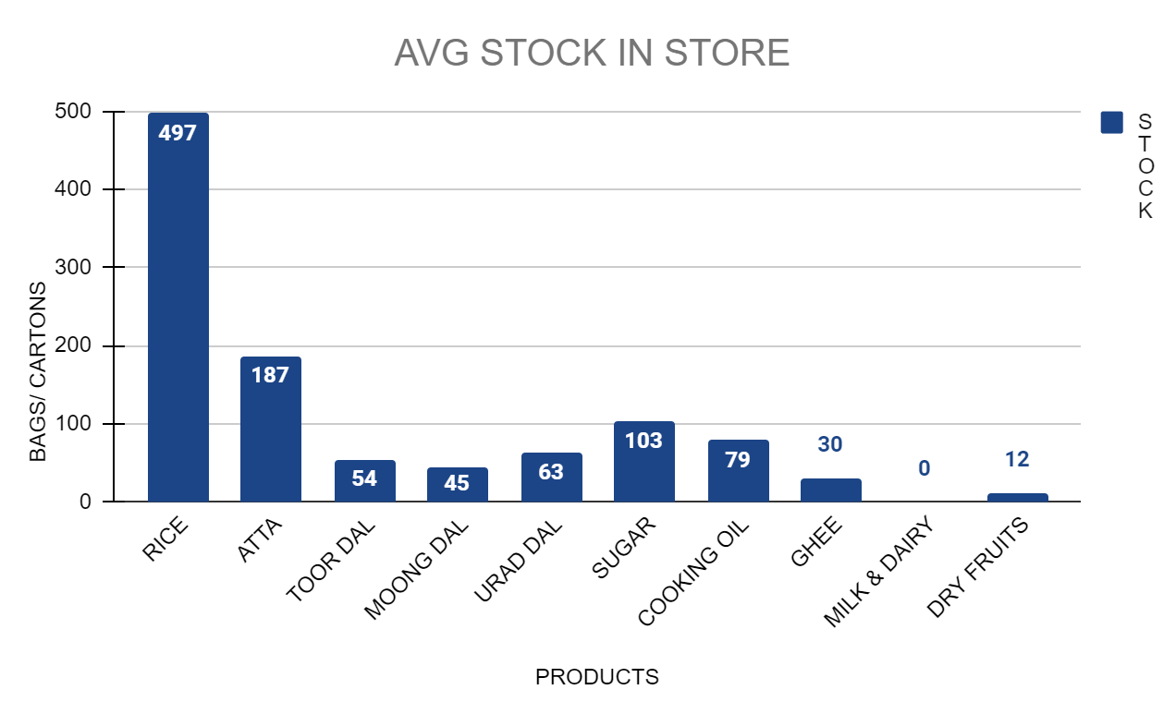
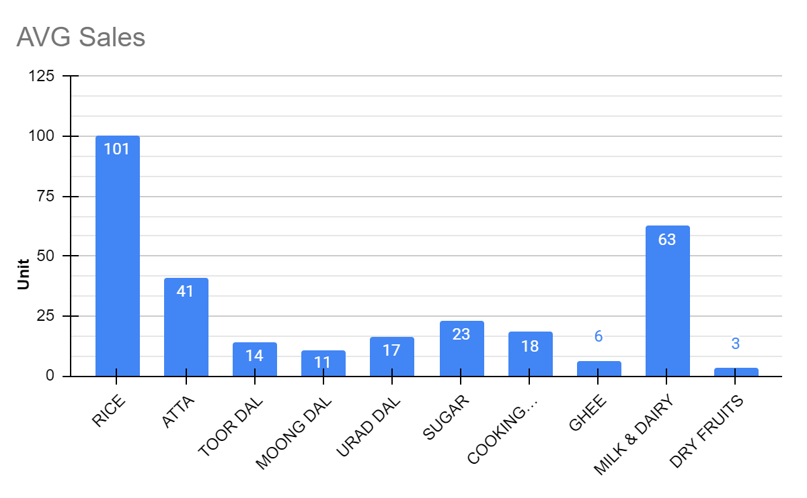
02
Data Analysis
Objective : 4 Inventory
There are no abnormalities
But as per owner claim there must be something wrong ?
There are no abnormalities in avg stock as per sales but there are high fluctuation / variance in stock present in the inventory for every SKU

Slide 9
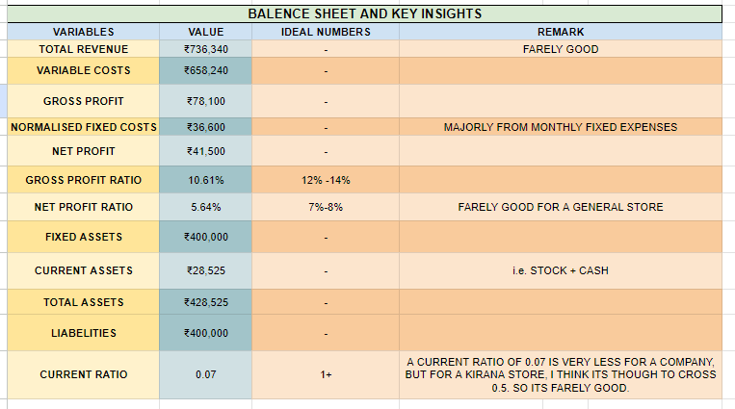
03
Findings (PL & Insights)

Slide 10
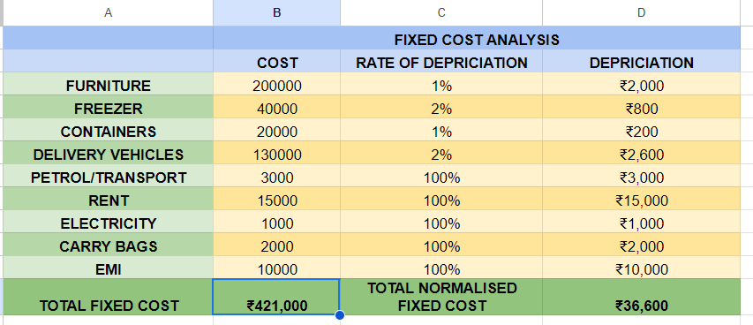
03
Findings (PL & Insights)

Slide 11

04
Finally Recommendations
1) Increase the sales of high profit item (such as :- Dry Fruits & Ghee)
2) Increasing Sales of Milk
3) Restock inventory earlier than usual or during high sales periods
4) Increase Current Ratio
6) Enhance Store Display
5) Effective Pricing Strategies

